Slide 1
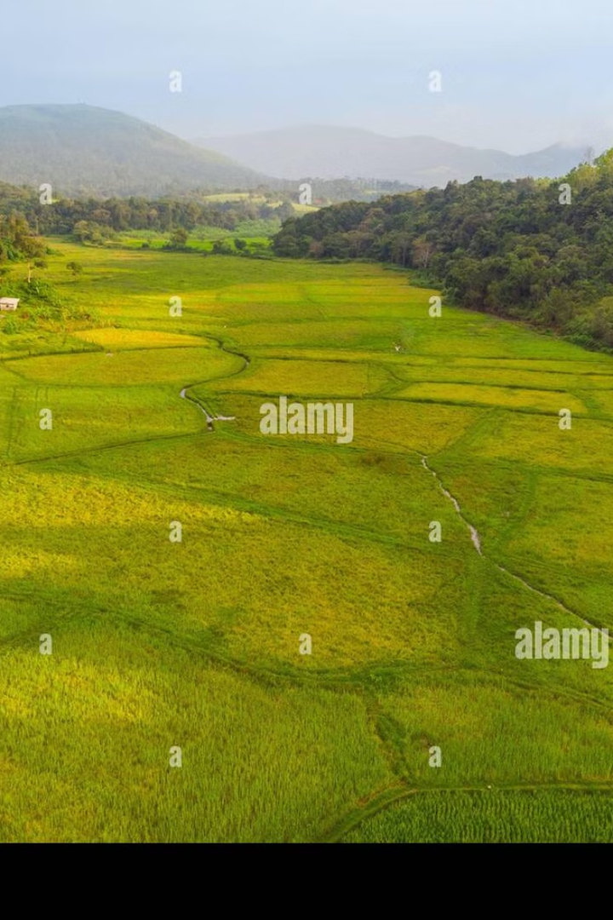

AI-Driven Crop Yield Prediction for Sustainable Agriculture in India
by Gautam

Slide 2
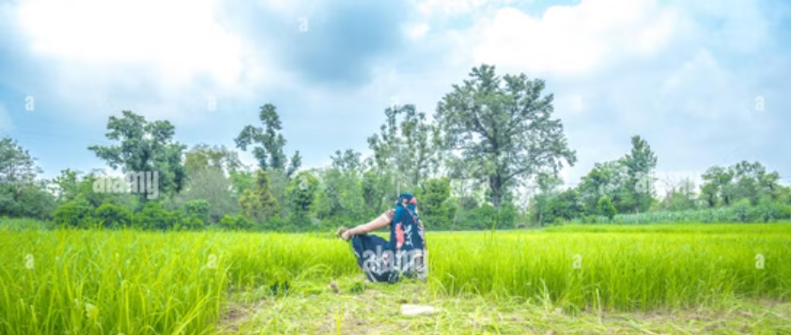
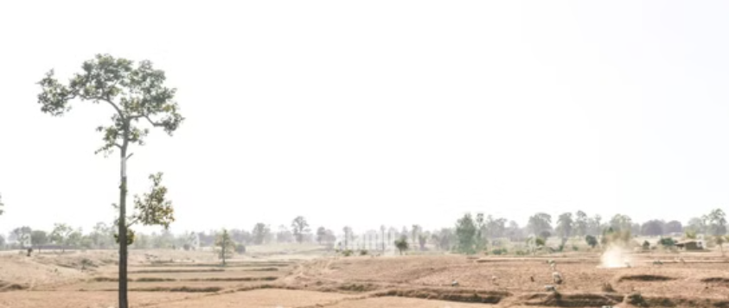
Introduction & Problem Statement

Slide 3

Objectives
Develop a machine learning model to predict crop yields.
Identify key factors influencing productivity.
Provide data-driven recommendations.
Create an interactive dashboard for real-time visualization.

Slide 4
Methodology
Workflow
Data Collection: Historical crop data, GeoJSON data.
Preprocessing: Normalization and feature engineering.
Model Development: Random Forest Regressor (R² = 0.89).
Deployment: Flask backend with D3.js/Chart.js frontend.

Slide 5
Predictive Model Architecture
Model Capabilities
Analyzed 12 key input variables.
Developed feature importance ranking.
89% accuracy machine learning pipeline.
Real-time prediction capabilities.

Slide 6


Key Findings / Results
Key Results
The system enables proactive decision-making for farmers and reduces resource waste by 20-25% through precision agriculture.

Slide 7
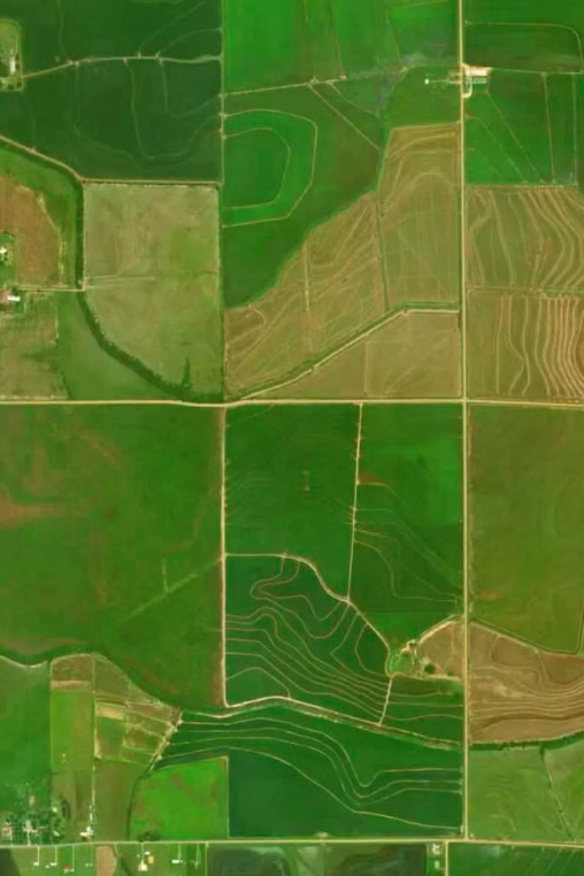
Future Directions
Integrate satellite imagery for soil health monitoring.
Expand to district-level predictions.
Add multilingual support.

